Slide 1
Structure from Motion
Some slides adapted from Steve Seitz, Rick Szeliski, Martial Hebert, Mark Pollefeys, etc.

Slide 2
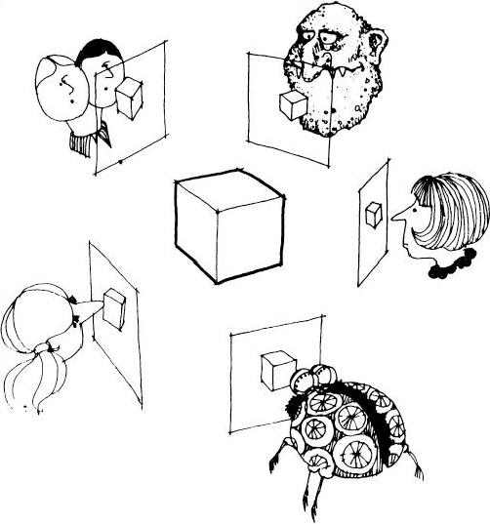
Multi-view Stereo
Slides from S. Seitz

Slide 3
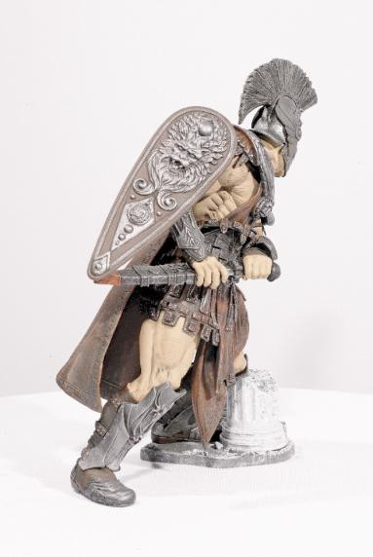
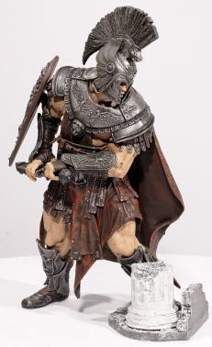
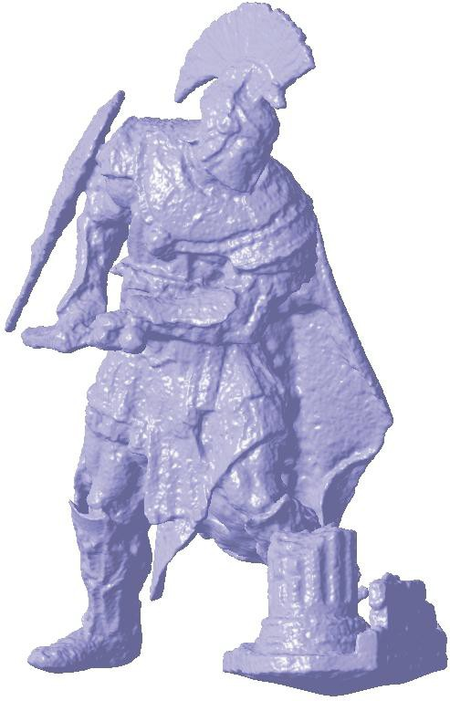
What is stereo vision?
Generic problem : given several 2D images of the same object or scene, compute a representation of its 3D shape
…

Slide 4
What is stereo vision?
Generic problem : given several 2D images of the same object or scene, compute a representation of its 3D shape
“Images of the same object or scene”
Arbitrary number of images (from two to thousands)
Arbitrary camera positions (isolated cameras or video sequence)
Cameras can be calibrated or uncalibrated
“Representation of 3D shape”
Depth maps
Meshes
Point clouds
Volumetric models
…

Slide 5
Structure from motion
Given: m images of n fixed 3D points
x_{ij} = P_{i} X_{j} , i = 1, … , m, j = 1, … , n
Problem: estimate m projection matrices P_{i} and n 3D points X_{j} from the correspondence points x_{ij}
X_{j}
^{x}1j
^{x}3j
^{x}2j
P
1
P₃
P₂
Slide: S. Lazebnik

Slide 6
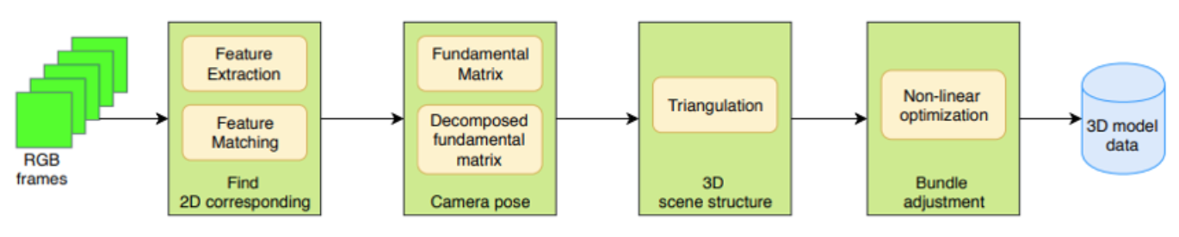
Structure from motion
Basic pipeline of SFM

Slide 7
Structure from motion
Feature Detection and Matching
SIFT, SURF, etc.
KNN
Camera Pose Estimation
Epipolar constraint
Fundamental matrix
Matrix decomposition
Sparse Point Cloud Generation
Triangulation
Minimize Projection Error
Bundler adjustment

Slide 8
Feature Detection and Matching
Why need to detect and match feature points?
A good way to construct the relationship between images

Slide 9
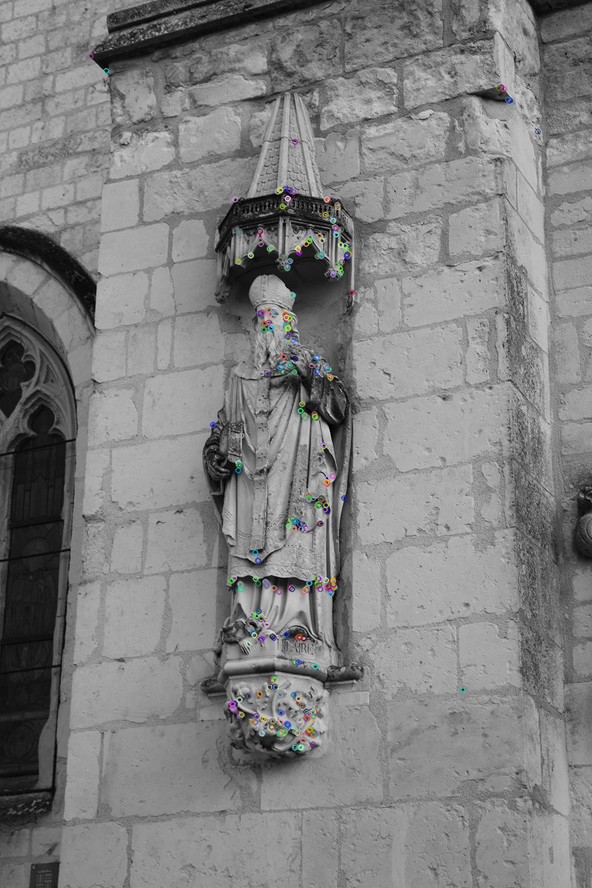
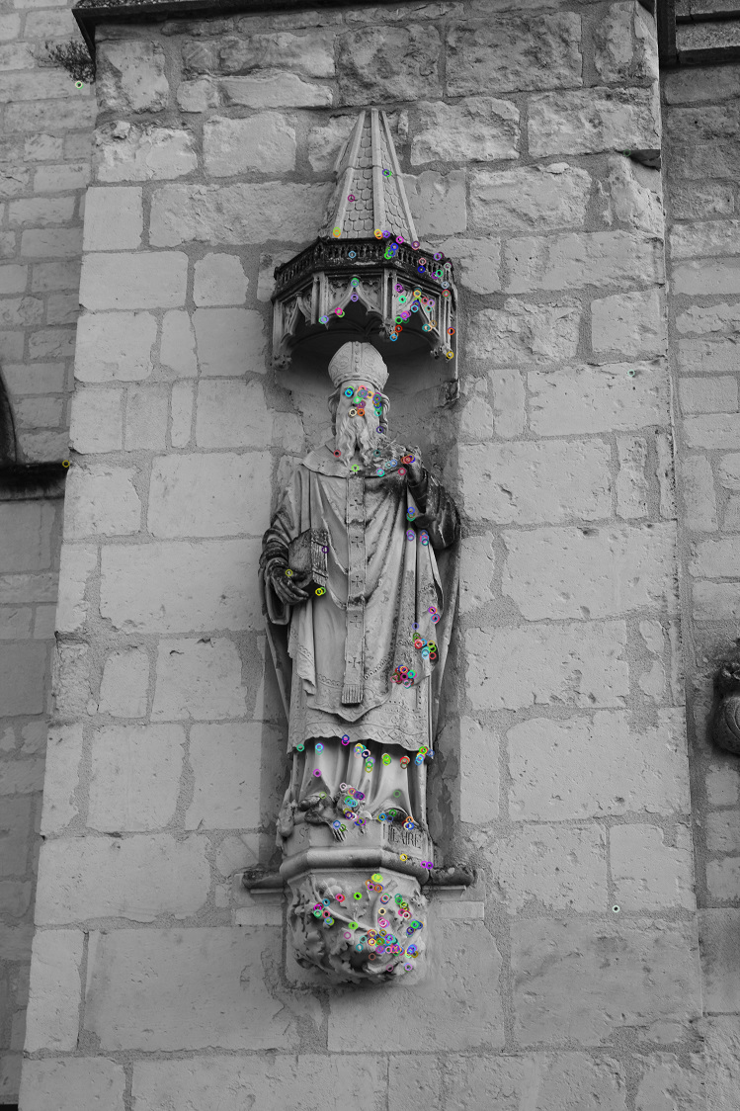
Feature Detection and Matching
Feature Detection Operators:
Scale-Invariant-Feature-Transform (SIFT)

Slide 10
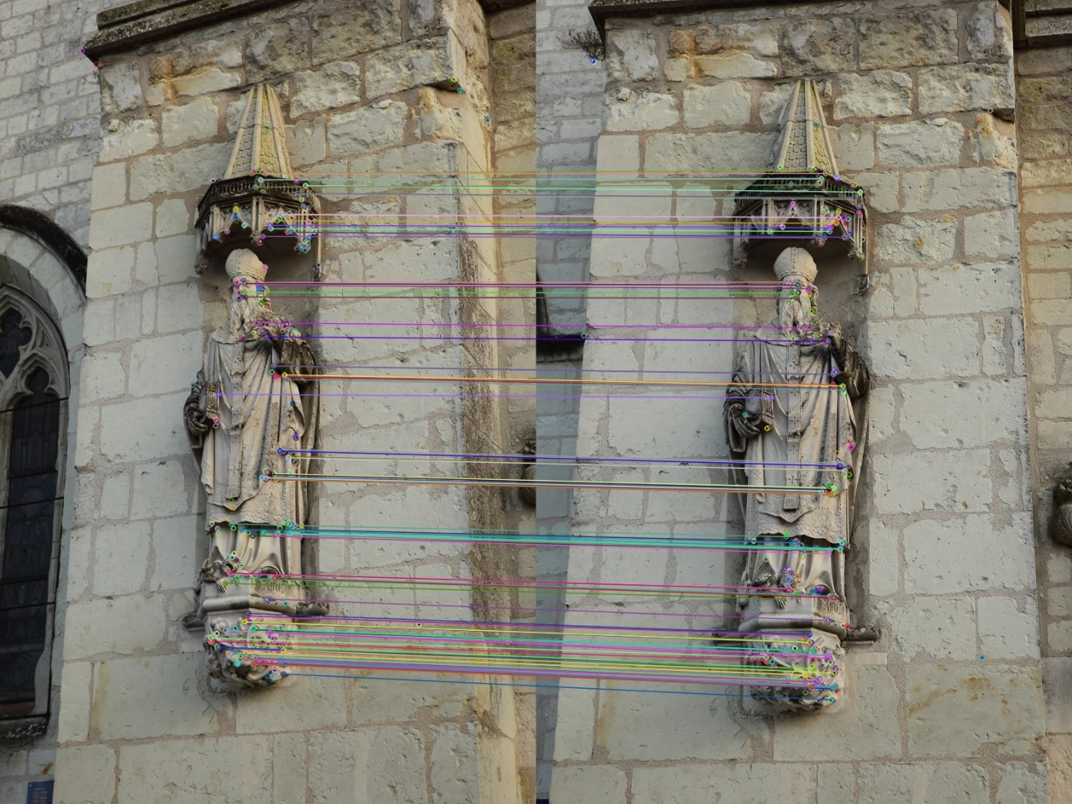
Feature Detection and Matching
Feature Points Matching
K-Nearest-Neighborhood (KNN)
Define distance function that compares two feature points
Find the corresponding feature point with minimal distance

Slide 11
Camera Pose Estimation
x_{ij} = P_{i} X_{j} , i = 1, … , m, j = 1, … , n
x
K
R
T
X
X_{j}
K: intrinsic parameters, 3*3
R: rotation matrix, 3*3
T: translation matrix, 3*1
^{x}1j
^{x}3j
^{x}2j
P
1
P₃
P₂

Slide 12
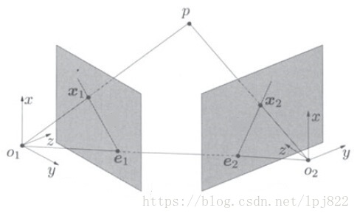
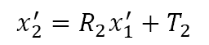
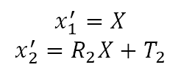
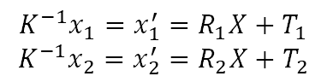
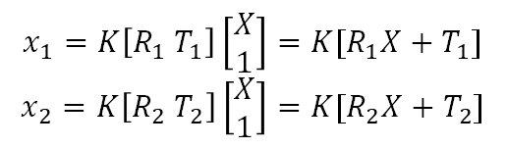
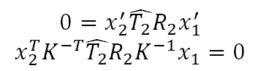
Epipolar Constraint
Given 3D point P with coordinate $X$, the projected points to 2D plane is $x_{1}, x_{2}$
$$x_{1}=K\left[R_{1} T_{1}\right]\left[\begin{aligned}X \\ 1\end{aligned}\right]=K[R_{1}X+T_{1}]$$
$$x_{2}=K\left[R_{2} T_{2}\right]\left[\begin{aligned}X \\ 1\end{aligned}\right]=K[R_{2}X+T_{2}]$$
$$K^{−1}x_{1}=x_{1}^{′}=R_{1}X+T_{1}$$
$$K^{−1}x_{2}=x_{2}^{′}=R_{2}X+T_{2}$$
Let the coordinate system of the first camera as the reference, thus $R_{1}=I, T_{1}=0$
$$x_{1}^{′}=X$$
$$x_{2}^{′}=R_{2}X+T_{2}$$
$$x_{2}^{′}=R_{2}x_{1}^{′}+T_{2}$$
$$0=x_{2}^{′}\hat{T_{2}}R_{2}x_{1}^{′}$$
$$x_{2}^{T}K^{−T}\hat{T_{2}}R_{2}K^{−1}x_{1}=0$$
Fundamental Matrix

Slide 13
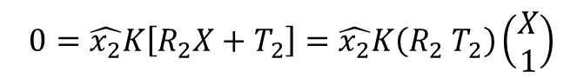
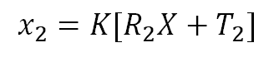
Sparse Point Cloud Generation
Triangulation
Based on the computed pose matrix and 2D coordinates, recover the real 3D coordinates
Apply SVD method to solve the problem
$$x_{2}=K[R_{2}X+T_{2}]$$
$$0=\hat{x_{2}}K\left[R_{2}X+T_{2}\right]=\hat{x_{2}}K\left(R_{2} T_{2}\right)\left(\begin{aligned}X \\ 1\end{aligned}\right)$$
More and more recovered 3D points form sparse point cloud

Slide 14
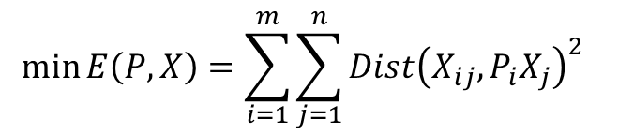
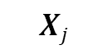
Minimize Projection Error
The error will accumulate as the images increase
Bundle adjustment
Non-linear method for refining structure and motion
Minimizing reprojection error
$$Xj$$
$$\min{E\left(P,X\right)=\sum_{i=1}^{m}{\sum_{j=1}^{n}{Dist{\left(X_{ij},P_{i}X_{j}\right)}^{2}}} }$$
P₁X_{j}
^{x}1j
^{x}3j
P₃X_{j}
P₂X_{j}
^{x}2j
P₁
P₃
P₂

Slide 15
Summary: Structure from motion
Feature points detection and matching
Pose estimation: solve pose for images that have the most matched point pairs
Triangulation: recover the 3D real points that have at least two cameras
Bundle adjustment
– For speed, only do full bundle adjustment after some percent of new images are processed

Slide 16
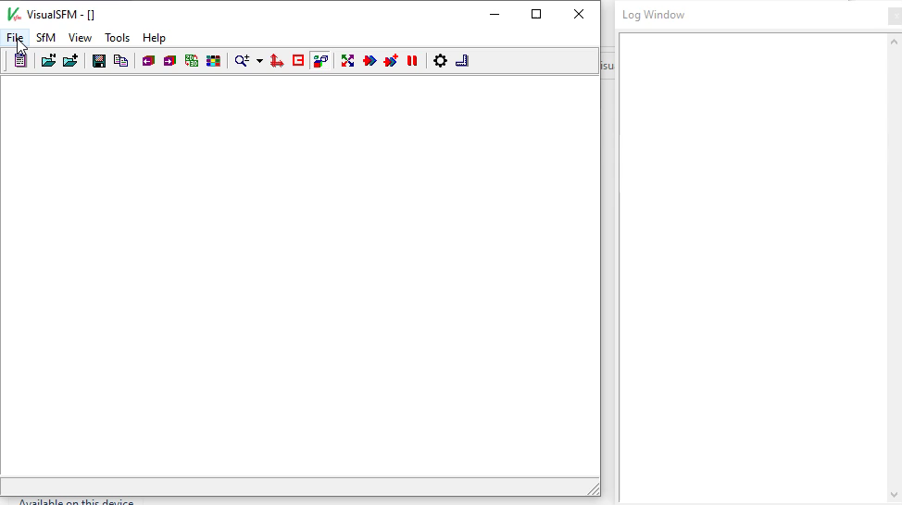
Demo

